Slide 1
Employee Data Analysis using Excel
STUDENT NAME: P.Divya
REGISTER NO: 312208475
DEPARTMENT: B.com (General)
COLLEGE: Chellammal women's college

Slide 2
PROJECT TITLE
Employee Performance Analysis
using Excel

Slide 3

AGENDA
Problem Statement
Project Overview
End Users
Our Solution and Proposition
Dataset Description
Modelling Approach
Results and Discussion
Conclusion

Slide 4

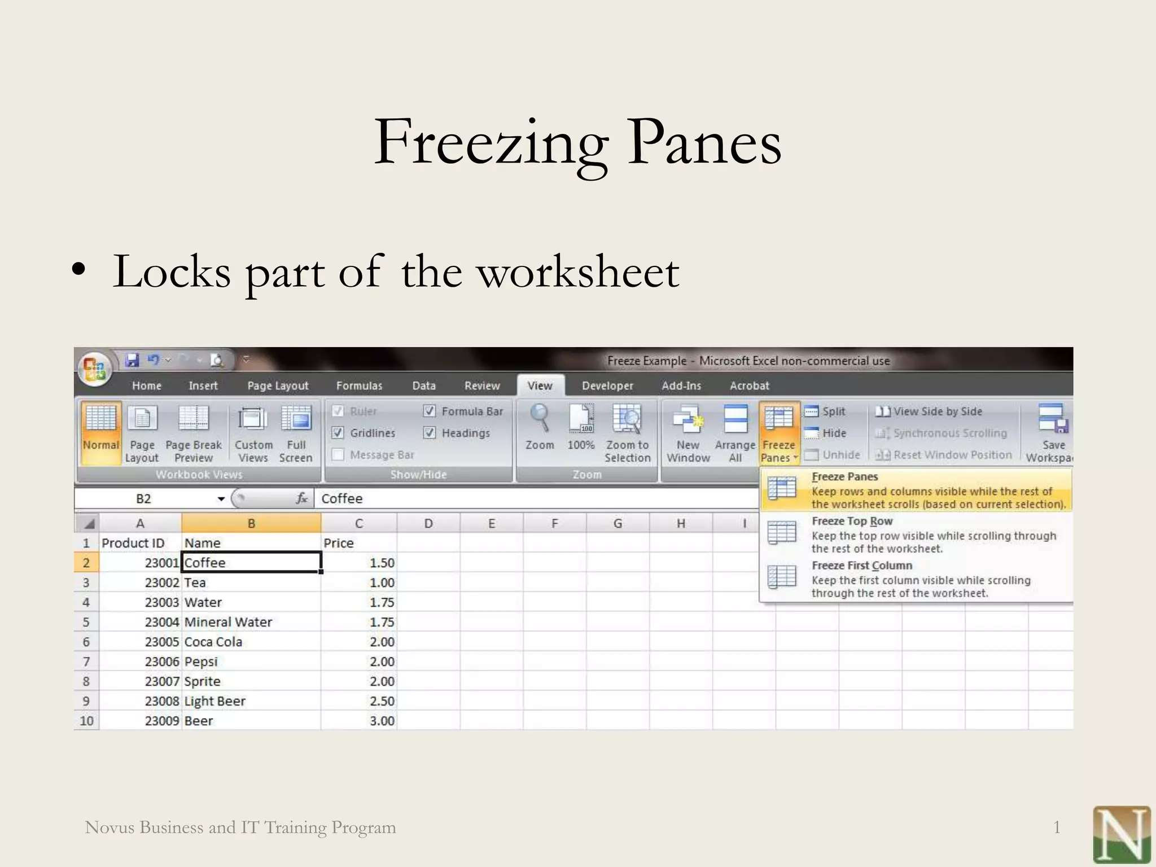

Slide 5

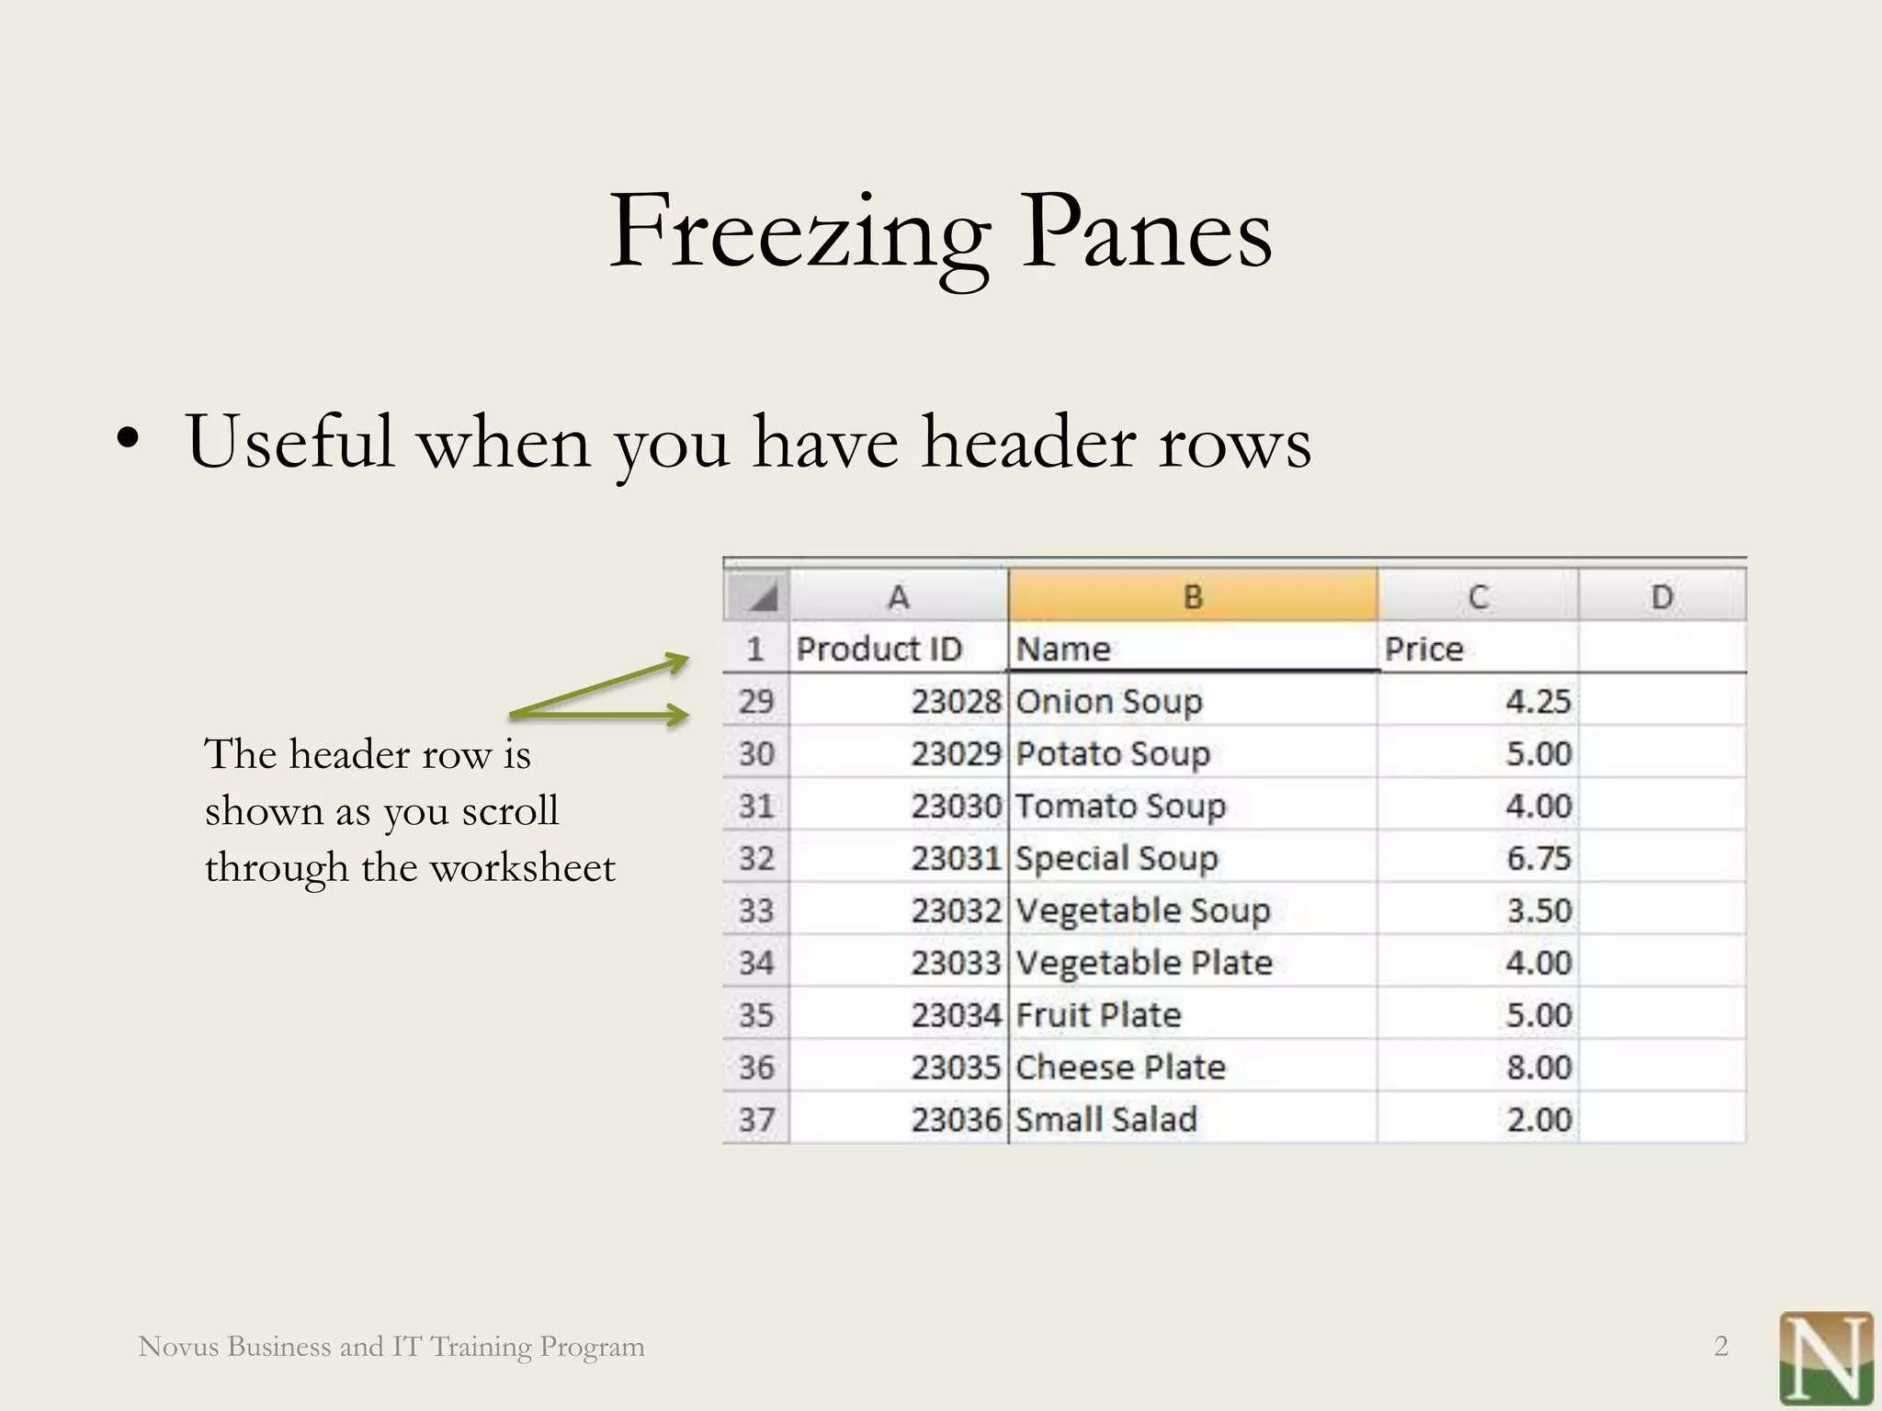

Slide 6
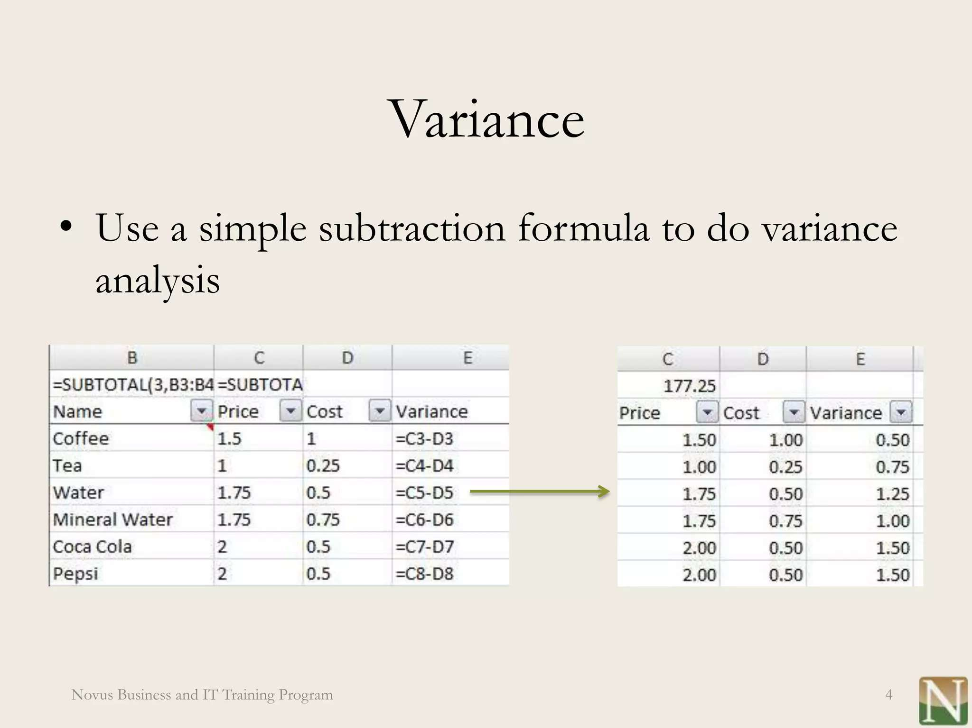

OUR SOLUTION AND ITS VALUE PROPOSITION

Slide 7
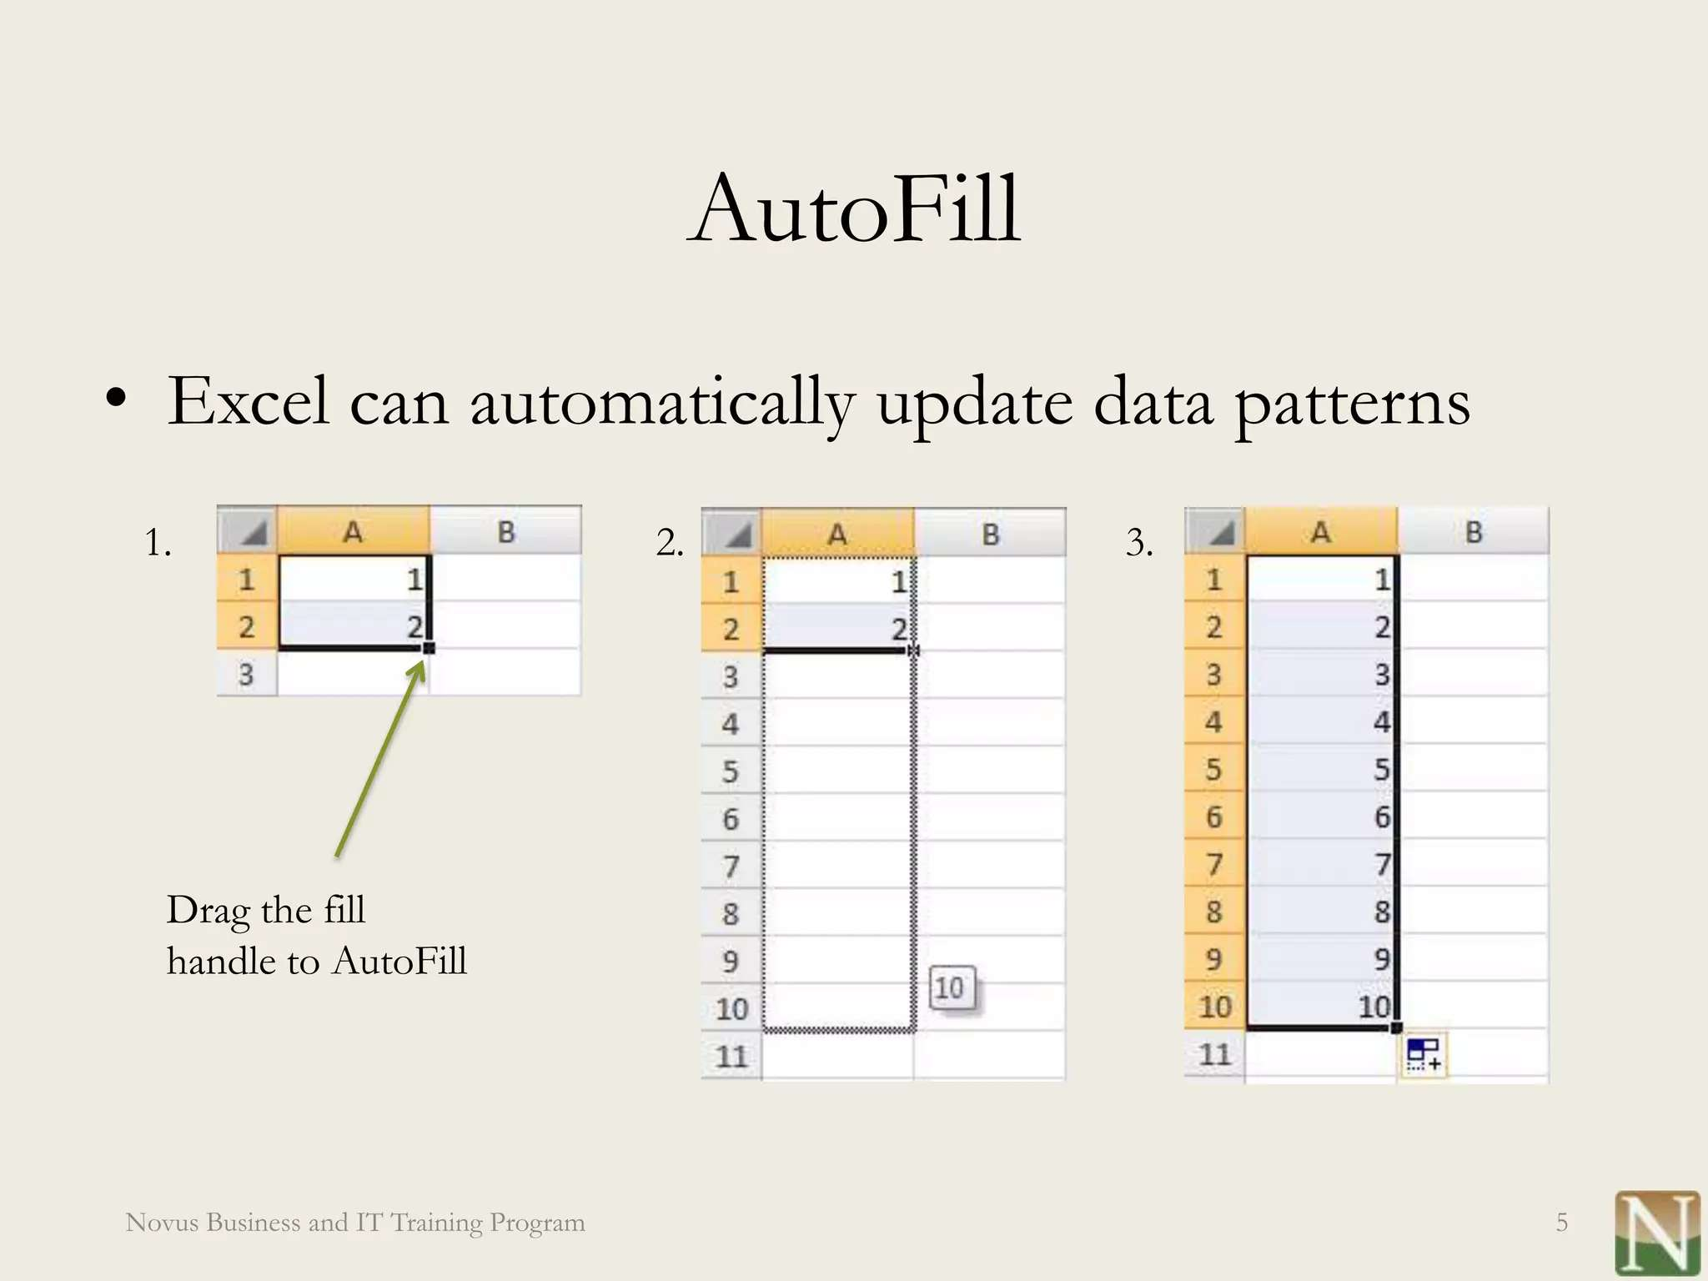
MODELLING

Slide 8
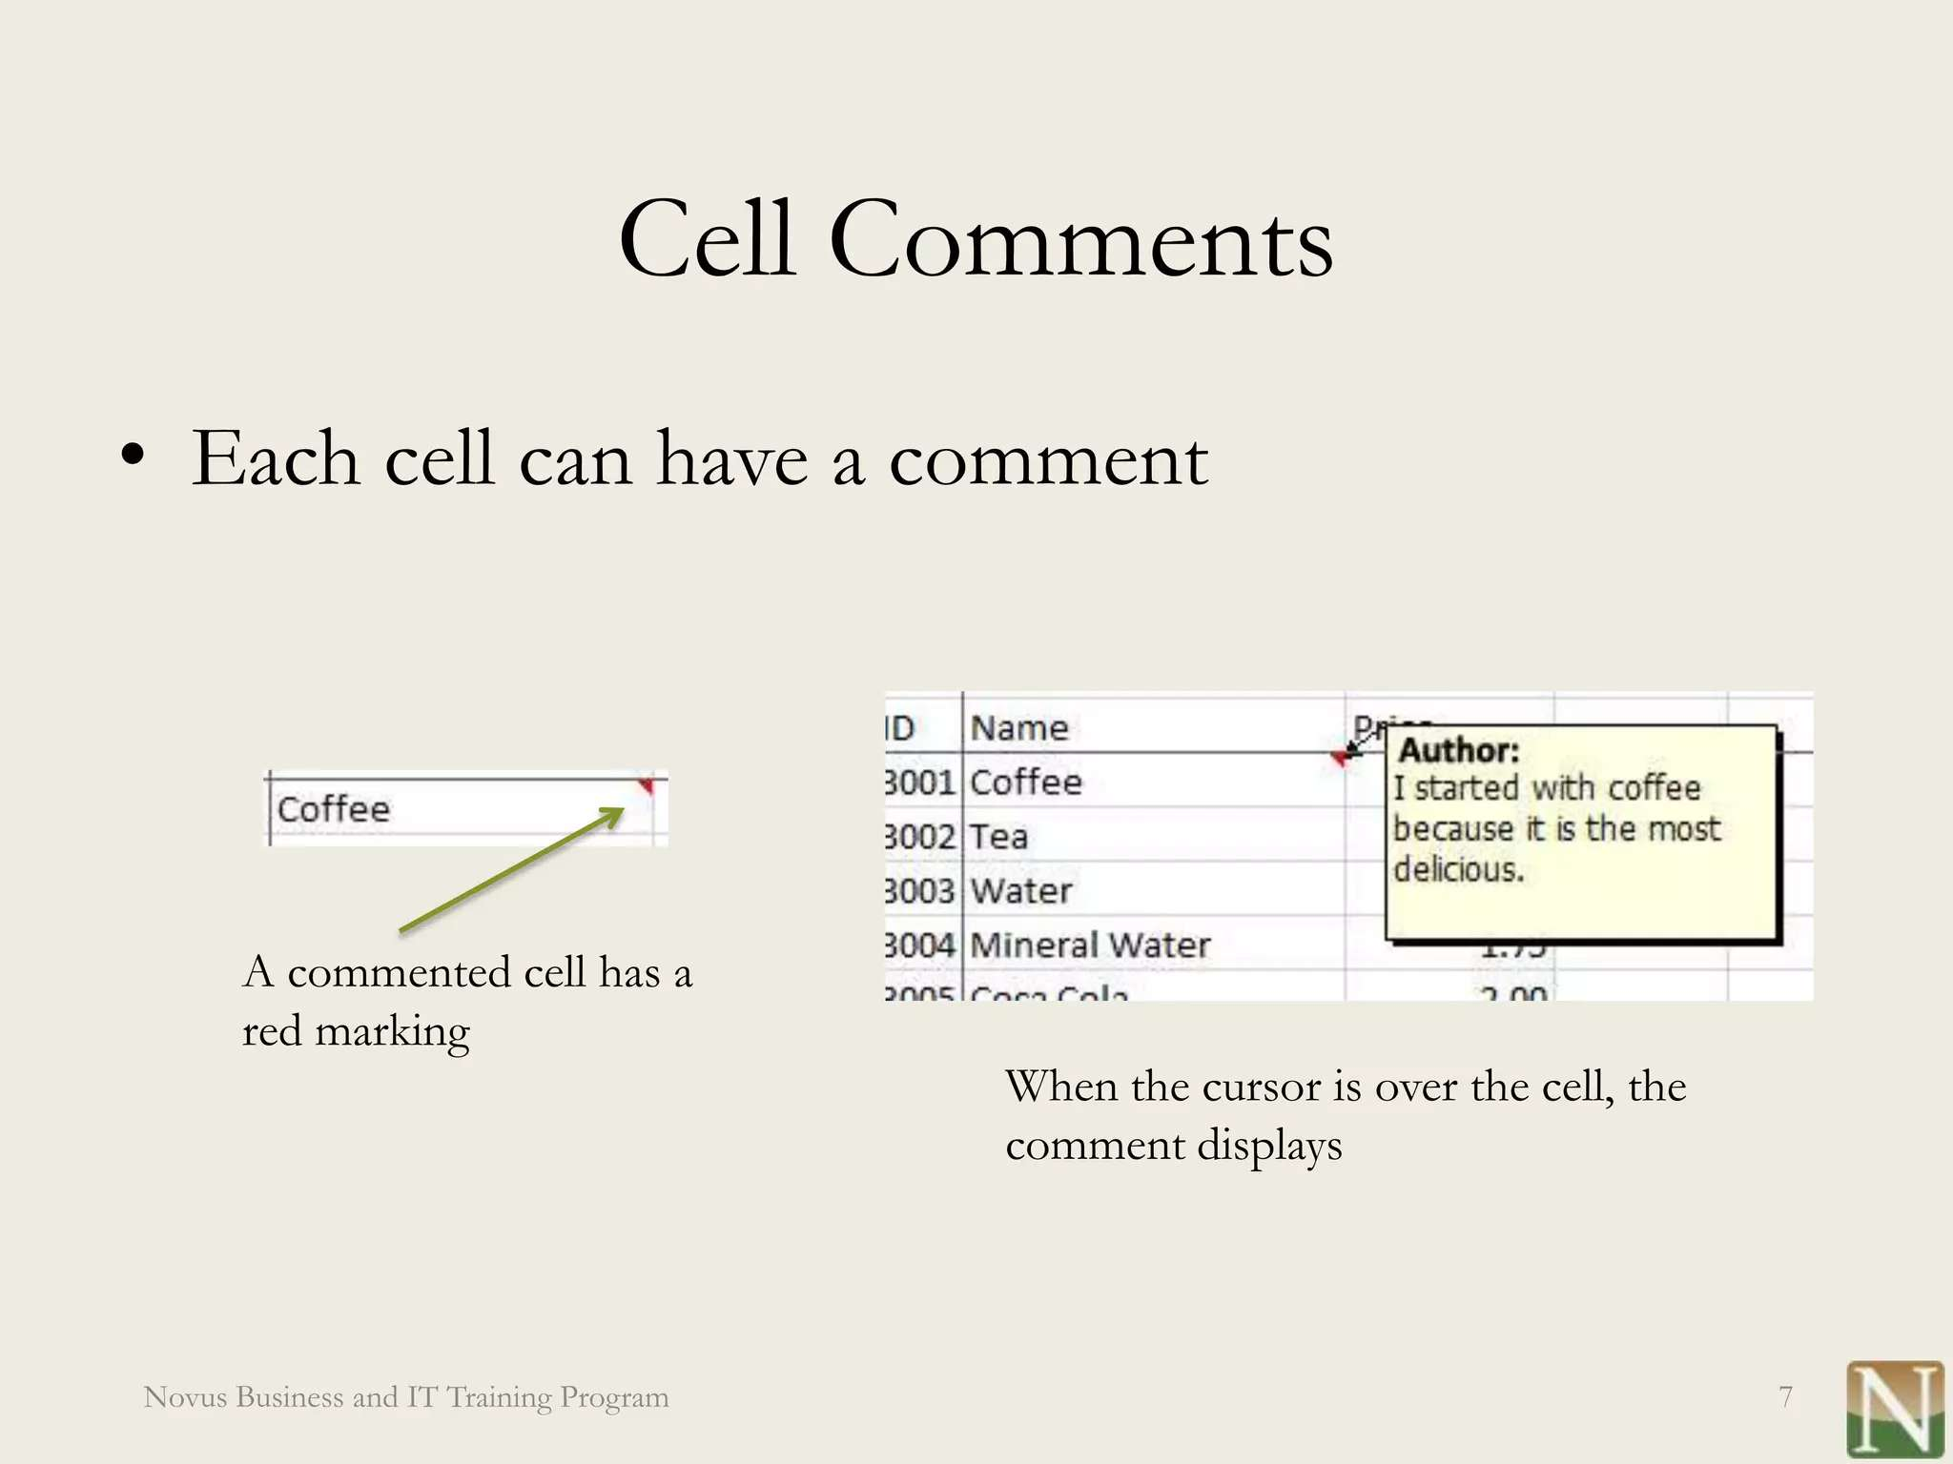

Slide 9
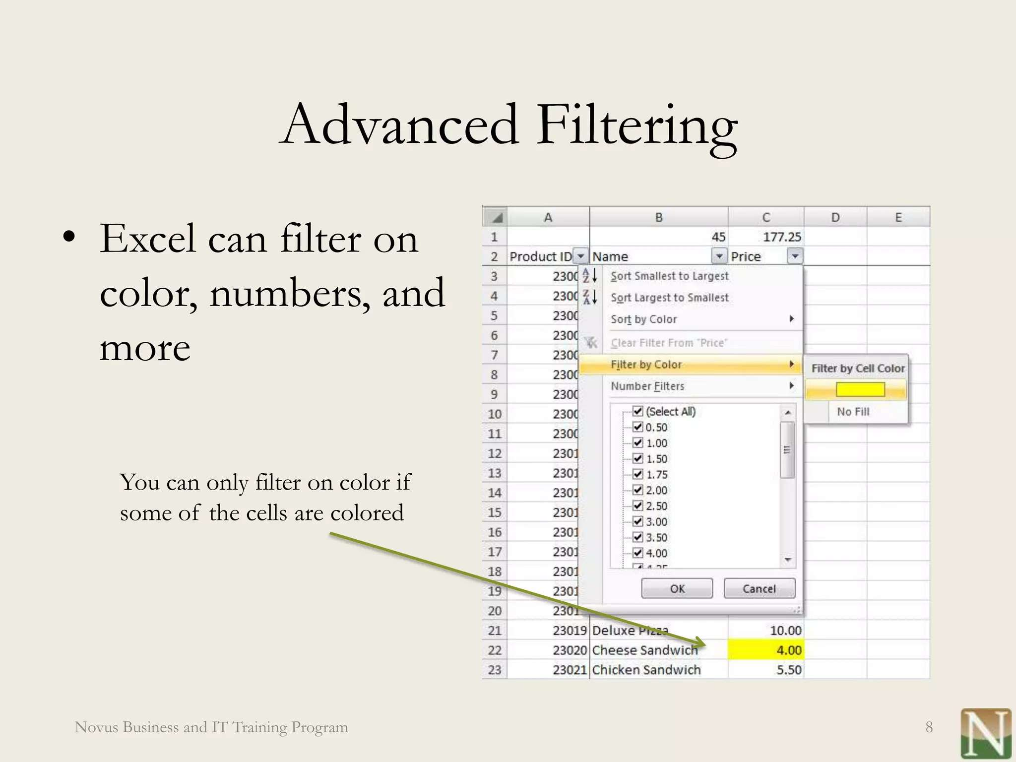

Slide 10
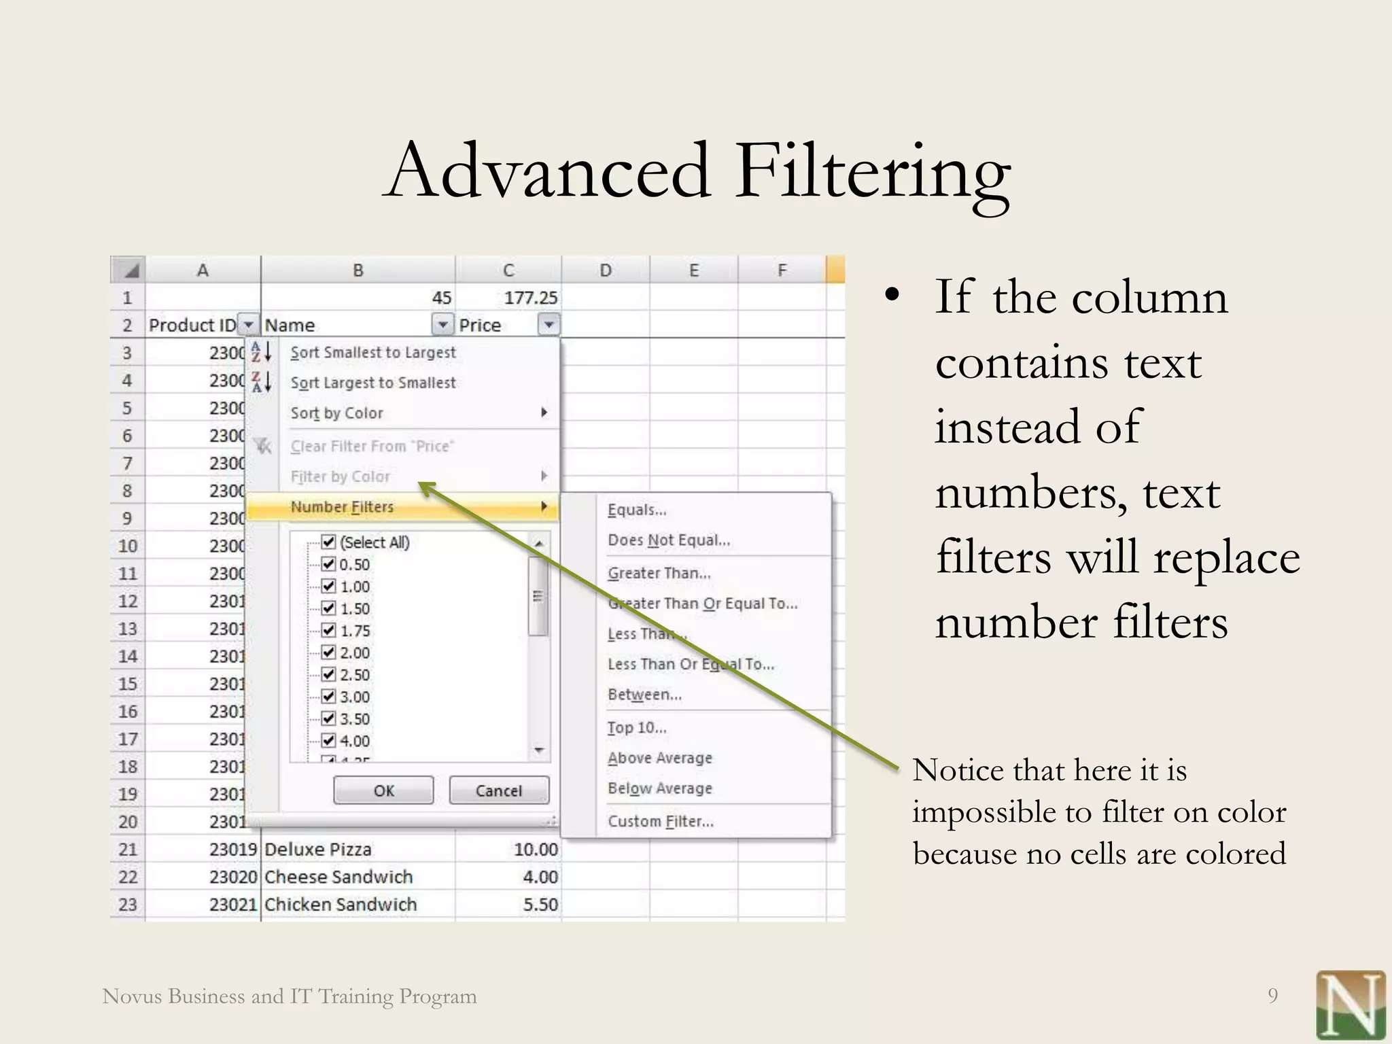
RESULTS

Slide 11
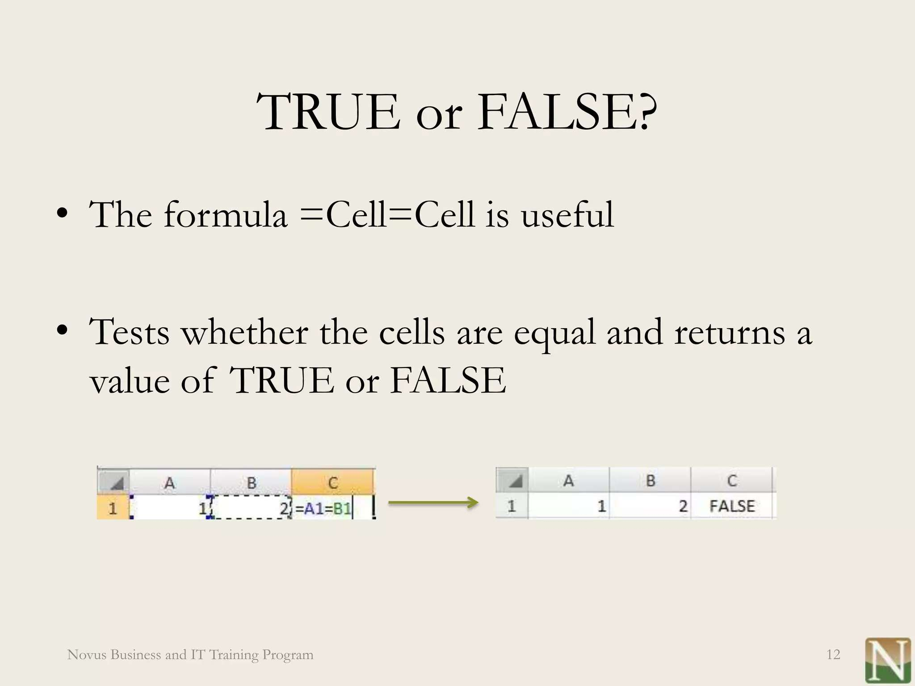

Slide 12
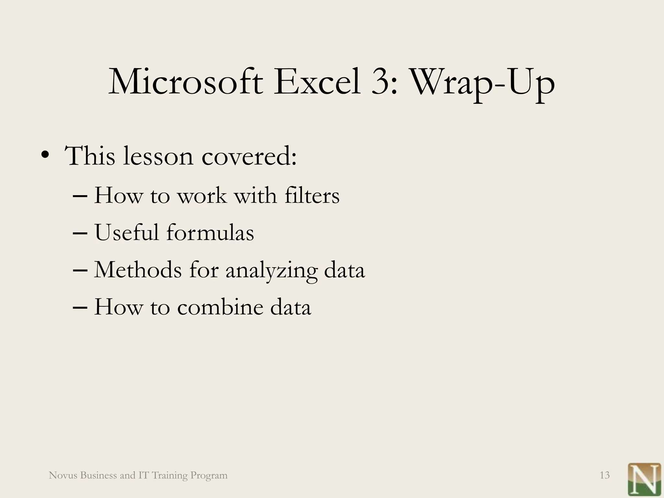
conclusion

Slide 13


